Slide 1

Aviation Safety Analysis
P1
PHASE ONE PROJECT
Business Understanding

Slide 2

TWO MAIN OBJECTIVES
BO
Business Objectives
- Determine which aircraft makes and models are associated with the fewest accidents.
- Identify safety trends across time, category, and injury severity.

Slide 3

Dataset Overview
**airline_accidents.csv file** and explore its structure.
**Key Questions:**
1. Which aircraft makes have the lowest accident rates?
2. What are the most common causes or conditions associated with accidents?
3. How have accident trends changed over time?

Slide 4

Data Analysis and Visualization
Data exploration summary
1. Top Aircraft Makes by Accident Count
2. Aviation Accidents Over Time
3. Distribution of Injury Severity

Slide 5
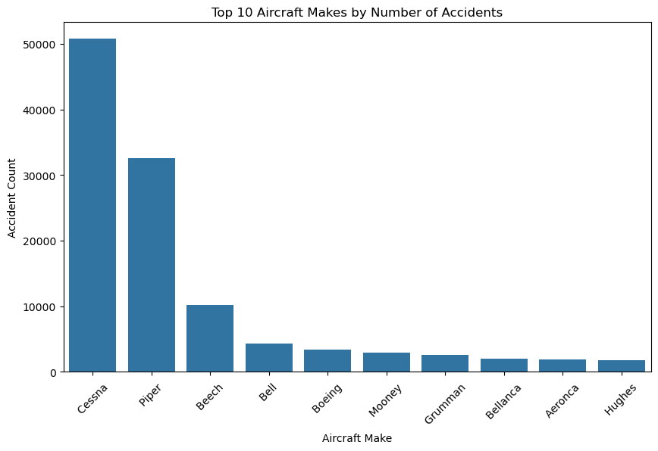
Chart and Explanation
Observation and interpretation
1. Top Aircraft Makes by Accident Count
Observation: Cessna and Piper dominate the number of recorded accidents, followed by Beech, Bell, and Boeing.
Interpretation: These brands have high accident counts primarily because they manufacture large fleets of small general aviation aircraft. This doesn’t necessarily mean they are unsafe — rather, they are the most widely used.
# Top 10 Aircraft Makes by Accident Count

Slide 6
2. Aviation Accidents Over Time
Observation and interpretation
Observation: Accident rates peaked in the late 1960s–1970s, followed by a steady decline.
Interpretation: This trend aligns with technological advances, better training, and stricter safety regulations.

Slide 7
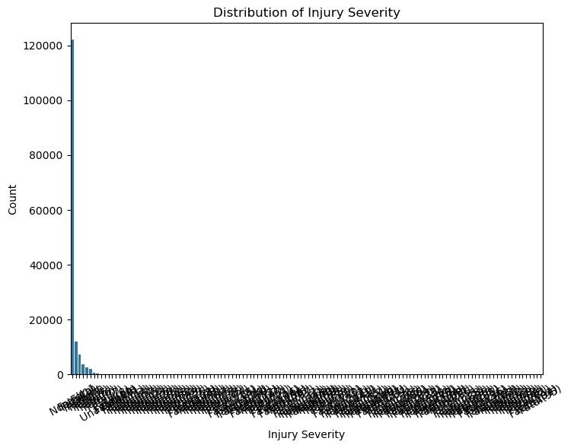
3. Distribution of Injury Severity
Observation and Interpretation
Observation: Most reported cases fall into “No Injury” or “Minor Injury” categories.
Interpretation: While accidents occur, fatal outcomes are relatively rare, emphasizing improved aircraft safety designs and response systems.

Slide 8
Business Insights The aviation industry has become significantly safer over time, suggesting that modern aircraft models are much lower-risk.
Business Recommendations
Invest in newer aircraft models — Data indicates accident frequency and severity have declined significantly in recent years.
Avoid older or overused aircraft types, especially small private planes (like older Cessna and Piper models) until condition and maintenance history are verified.
Partner with manufacturers that emphasize safety and maintenance — brands with strong safety records (modern Boeing, Airbus) are lower-risk investments

Slide 9
Thank You.
Victor Onyango
+254706465235
victor.onyango4@student.moringaschool.com

